Slide 1
Econ 106
Lecture 17
slides derived from:
https://r4ds.had.co.nz/graphics-for-communication.html

Slide 2
Reminders
Lab #5 is due Sunday, 11:59pm (best 4 out of 5 count towards your grade)
Research Milestone #3 can be turned in until 11:59pm tonight (late penalty)
Final project is due Sunday 11:59pm
https://pollev.com/vsovero

Slide 3
Grading: Written Report
Things I will be evaluating:
Does your writeup follow the structure of the outline?
Do you have a strong hypothesis/objective?
Are your visualizations clearly connected to the objective?
Can you interpret your visualizations correctly?
Can you provide a reason for the observed trends in your visualizations?
Can you connect the findings to your objective?
Does your research project reflect independent thought and originality?

Slide 4
Student Example 1: Police Stops in Oakland

Slide 5
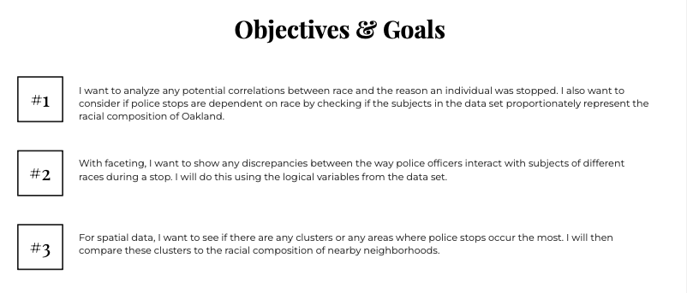

Slide 6
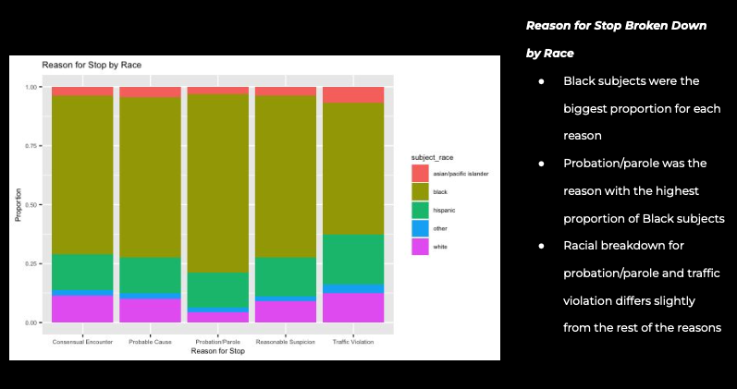

Slide 7
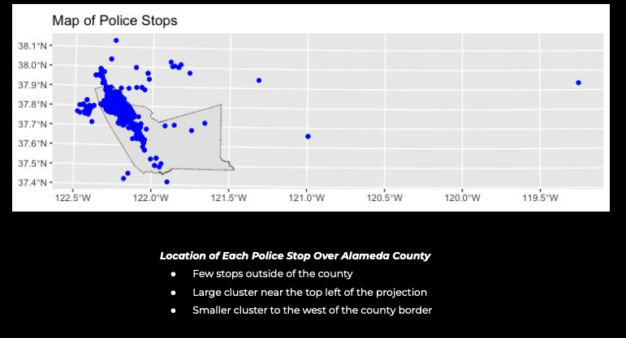

Slide 8
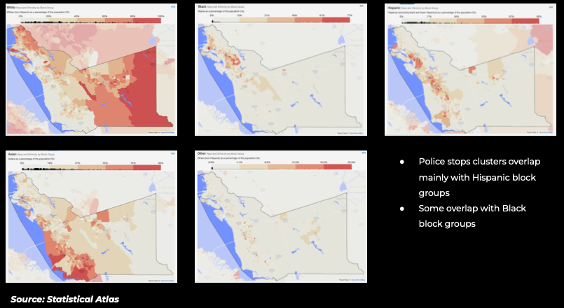
Student compiled additional information to provide context for the results.

Slide 9
Student Example 2: Mortality and Mental Health

Slide 10
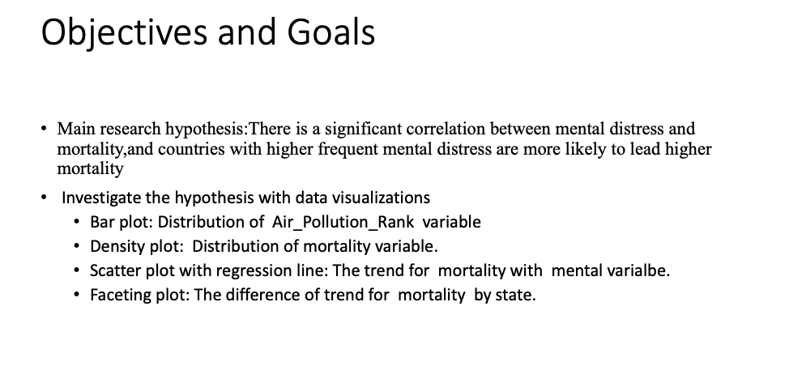
Clear objective, but it is unclear how the visualizations are tied to the objective

Slide 11
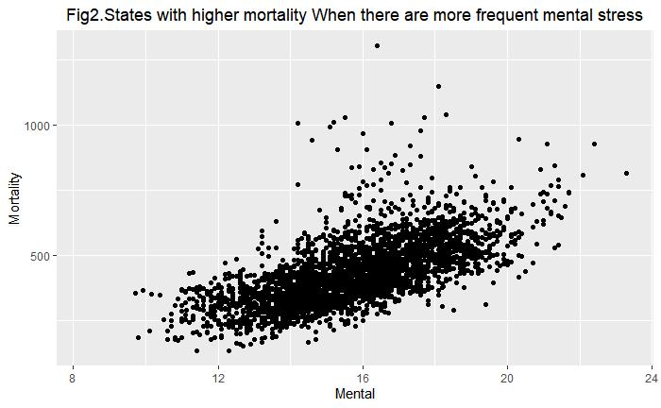
Scatter plot
Most strongly tied to objective (relationship between mental health and mortality)

Slide 12
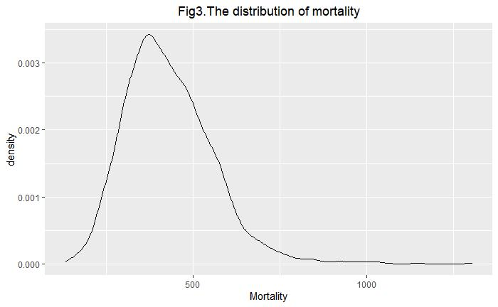
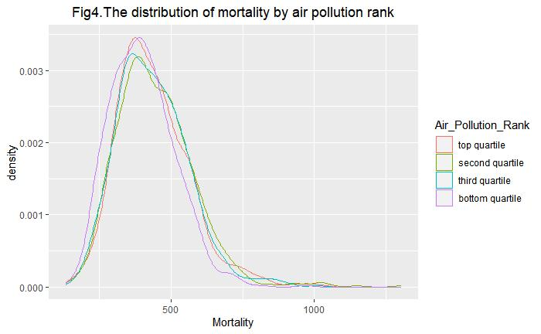
Density Plot
no clear connection to objective (mental health and mortality)

Slide 13
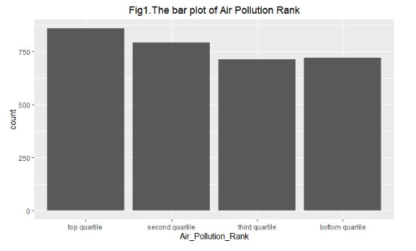
Bar Plot
Not clear how this graph helps investigate the objective (number of counties by air pollution quartile)
Only has one variable

Slide 14
Outline
Exploratory vs Explanatory Plots
Visualization Best Practices
Customizing your plots

Slide 15
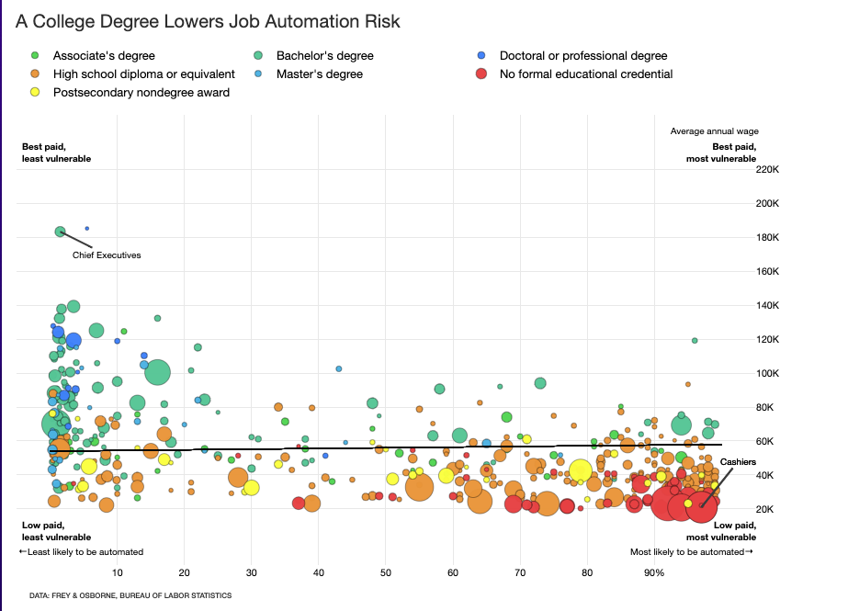
#tidytuesday
https://connorrothschild.github.io/v2/post/tidy-tuesday-replication/

Slide 16
Exploratory vs Explanatory Plots
As you move further into your data analysis, you will shift from making exploratory plots to explanatory plots.
Exploratory Plots:
data displays to help you better understand and discover hidden patterns in the data you’re working with.
Explanatory Plots:
data displays that aim to communicate insights to others.

Slide 17
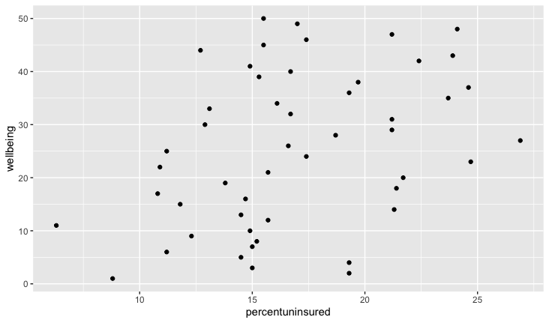
Exploratory Plot Example
When exploring your data, you will make a lot of plots
They won’t have a lot of formatting/labeling
These plots are for “internal use”- they help you understand your data

Slide 18
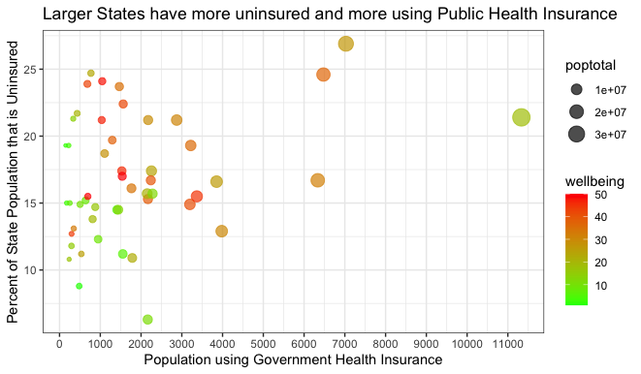
Explanatory Plot Example
These are plots for “external use”- communicating your findings to others
Things to check:
the axis labels should all be clear
the labels should all be large enough to read
the colors should all be carefully chosen

Slide 19
Communicating Your Findings with Plots
Ask yourself: What is the central message you are trying to communicate?
Decide, then build your plot around that message.
Make that message as easy to see as you can.
Remove the clutter -- get rid of any features of the visualization that do not contribute to the central message.

Slide 20
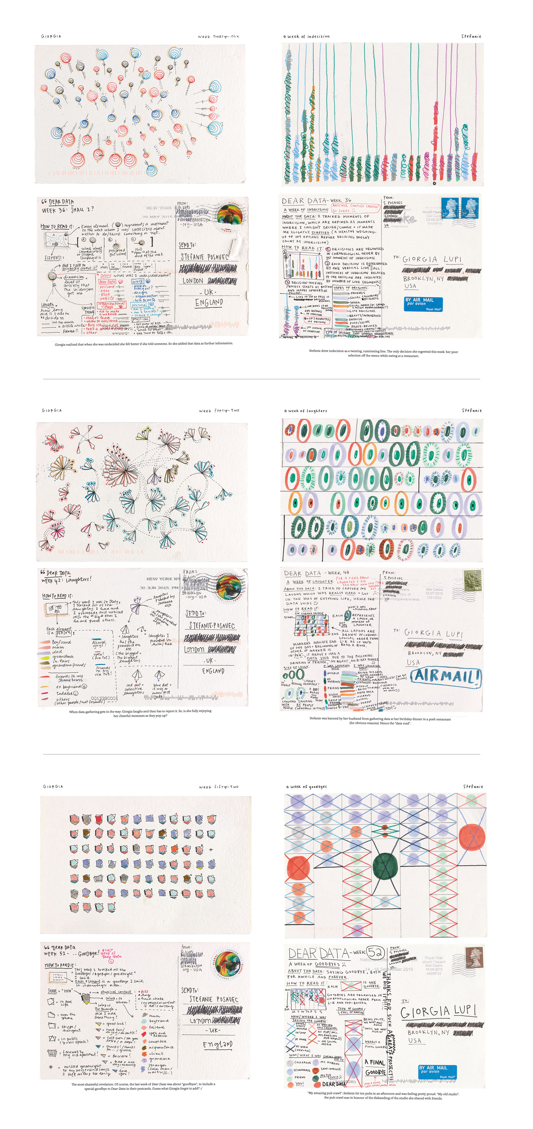
Data Visualization as Art
http://www.dear-data.com/theproject

Slide 21
Data Example for today
We’re going to use data from the cspp package (https://github.com/IPPSR/cspp )
cspp_data <- get_cspp_data(vars=c("percentuninsured", "wellbeing", "sdce", "doctorsPerCapita","higrenew", "popgovhealthins", "popnohealthins", "popprivhealthins", "hmdindex", "health_pro" ),
years = seq(2010,2010))

Slide 22
Plot Adjustments
Labels
title
x and y axis
annotations
Scales
x and y axis
color

Slide 23
Example
ggplot(data=cspp_data,
mapping=aes(x=percentuninsured, y=wellbeing))+
geom_point()
Let’s see what we can do to improve this scatter plot of a state’s well being ranking against the percent of the state population that is uninsured
Notes:
Now that we’ve got an informative graph of species observations over the years, let’s get it publication ready.
· First, I’d remove the gray background and
· Make the axis labels more descriptive
· As well as increasing the font size
· We can do this using premade themes and the theme function

Slide 24
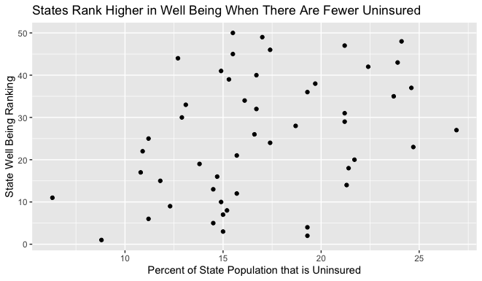
Labels
ggplot(data=cspp_data,
mapping=aes(x=percentuninsured, y=wellbeing))+
geom_point()+
labs(title = 'States Rank Higher in Well Being When There Are Fewer Uninsured',
x = 'Percent of State Population that is Uninsured',
y = 'State Well Being Ranking' )
labs() - specify labels
Arguments:
title: plot title
x: x axis label
y: y axis label
Notes:
This theme is nicer, but we can tweak it to make it exactly what we want. For example, you might want to change the wording on the axis labels. You can do this using the labs() function.
Demo 12:
· Copy paste Demo 9
· Add labs function with title, x and y as arguments
o Title is the plot title (Observed species in time)
o X is x axis label (year of observation)
o Y is y axis label (count)

Slide 25
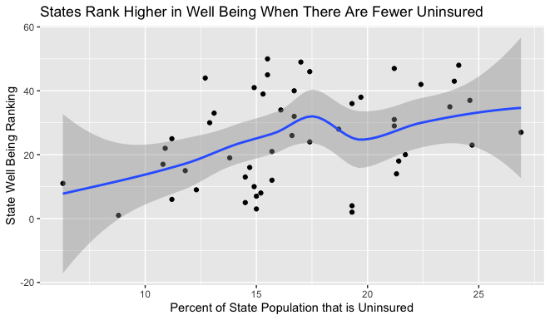
Add line of best fit
ggplot(data=cspp_data,
mapping=aes(x=percentuninsured, y=wellbeing))+
geom_point()+
labs(title = 'States Rank Higher in Well Being When There Are Fewer Uninsured',
x = 'Percent of State Population that is Uninsured',
y = 'State Well Being Ranking' )+
geom_smooth()
We can use geom_smooth() to add a line of best fit (expected value of y for every value of x)

Slide 26
Add line of best fit
Blue line: estimated line of best fit
Interpretation:
mostly negative relationship between percent uninsured and ranking
seems mostly linear
Dark grey: 95% CI for estimated line of best fit
Interpretation: the relationship is not precisely estimated for the very low and high values of percent uninsured (wide bands)

Slide 27
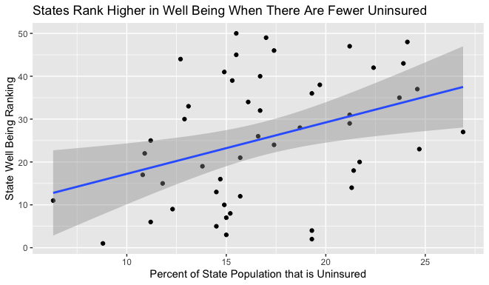
Make it linear
ggplot(data=cspp_data,
mapping=aes(x=percentuninsured, y=wellbeing))+
geom_point()+
labs(title = 'States Rank Higher in Well Being When There Are Fewer Uninsured',
x = 'Percent of State Population that is Uninsured',
y = 'State Well Being Ranking' )+
geom_smooth(method= "lm")
estimate a straight line with the method argument

Slide 28
Class Exercise
Create a scatter plot with doctors per capita on the x-axis and well being ranking (1-best, 50-worst) on the y-axis
add a line of best fit (try linear and nonlinear)
https://pollev.com/vsovero

Slide 29
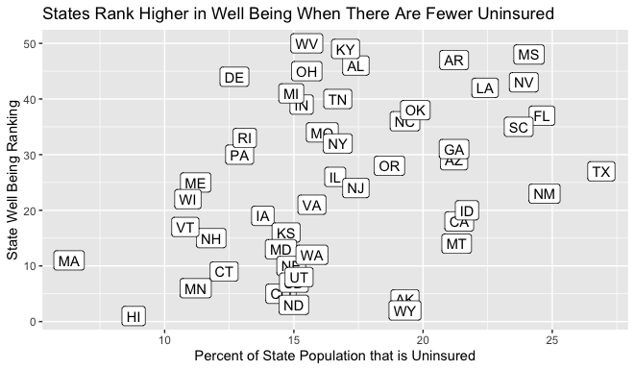
Annotations
In addition to labelling major components of your plot, it’s often useful to label individual observations or groups of observations.

Slide 30
Annotations
ggplot(data=cspp_data,
mapping=aes(x=percentuninsured, y=wellbeing))+
geom_point()+
labs(title = 'States Rank Higher in Well Being When There Are Fewer Uninsured',
x = 'Percent of State Population that is Uninsured',
y = 'State Well Being Ranking' )+
geom_label(aes(label=st )
geom_label() – add annotations to a geom
Arguments:
label
Remember to use aes() when referencing variable names

Slide 31
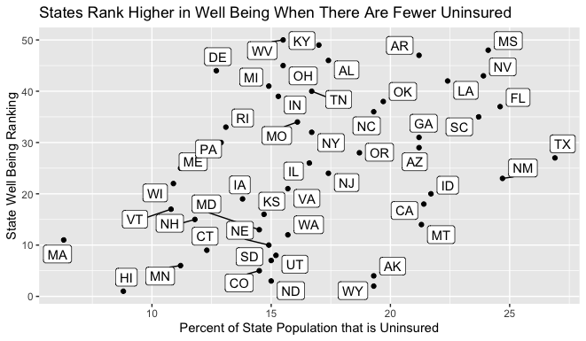
Annotations
The annotations can get cluttered if they are too close to one another
We can shift the labels away from the points using geom_label_repel() from the ggrepel package

Slide 32
ggrepel package
ggplot(data=cspp_data,
mapping=aes(x=percentuninsured, y=wellbeing))+
geom_point()+
labs(title = 'States Rank Higher in Well Being When There Are Fewer Uninsured',
x = 'Percent of State Population that is Uninsured',
y = 'State Well Being Ranking' )+
geom_hline(yintercept=25, color='red' )+
geom_label_repel(aes(label=st)

Slide 33
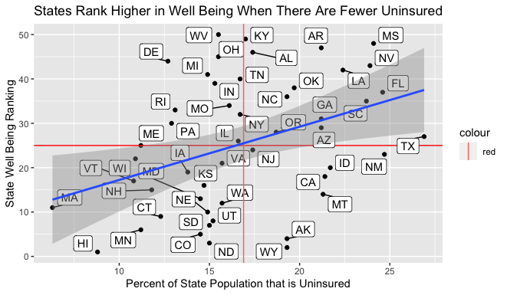
Quick PSA: don’t overdo it
You can definitely put too much on a graph
This looks like a hot mess

Slide 34
Class Exercise
Create a scatter plot with doctors per capita on the x-axis and well being ranking (1-best, 50-worst) on the y-axis
label the states using ggrepel
https://pollev.com/vsovero

Slide 35
Scales
Scales control how your data is mapped on your plot
Some common adjustments:
axis ticks and labels
colors

Slide 36
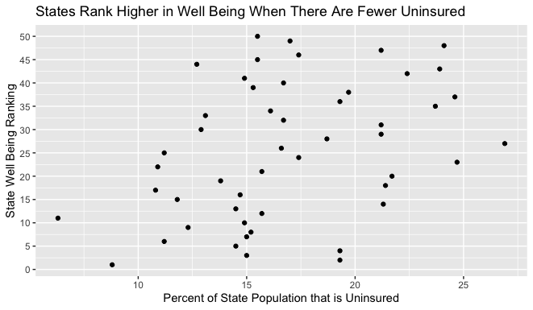
Continuous Scales
ggplot(data=cspp_data,
mapping=aes(x=percentuninsured, y=wellbeing))+
geom_point()+
labs(title = 'States Rank Higher in Well Being When There Are Fewer Uninsured',
x = 'Percent of State Population that is Uninsured',
y = 'State Well Being Ranking' )+
scale_y_continuous(breaks=seq(0,50, by=5))
The scale of your plot for continuous variables can be controlled using:
scale_x_continuous()
scale_y_continuous()

Slide 37
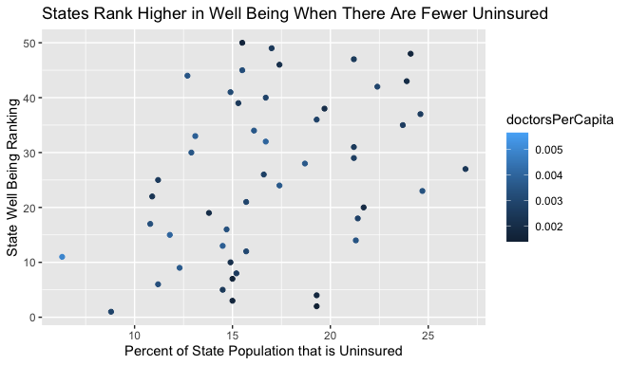
Color Scales
ggplot(data=cspp_data,
mapping=aes(x=percentuninsured, y=wellbeing))+
geom_point(aes(color=doctorsPerCapita)+
labs(title = 'States Rank Higher in Well Being When There Are Fewer Uninsured',
x = 'Percent of State Population that is Uninsured',
y = 'State Well Being Ranking' )
ggplot will automatically pick a sequential color scale when we map a quantitative variable to color

Slide 38
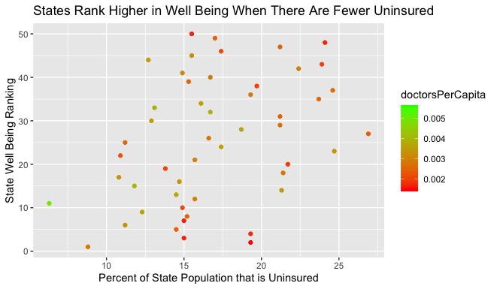
Color Scales
We can adjust the color scales for quantitative variables using scale_color_gradient()
You can set the colors on the high and low ends of the scale:
red
green

Slide 39
Color Scales
ggplot(data=cspp_data,
mapping=aes(x=percentuninsured, y=wellbeing))+
geom_point(aes(color=doctorsPerCapita)+
labs(title = 'States Rank Higher in Well Being When There Are Fewer Uninsured',
x = 'Percent of State Population that is Uninsured',
y = 'State Well Being Ranking' )+
geom_label_repel(aes(label=st )+
scale_color_gradient(low="red", high="green”)
We can adjust the color scale manually by picking the colors in the high and low end
the red-green color scale allows us to convey whether a number is “good” or “bad”

Slide 40
Class Exercise
Create a scatter plot with doctors per capita on the x-axis and well being on the y axis
color the points with percent uninsured using a green and red gradient (green low, red high)

Slide 41
Color Scales for Categorical Variables
scale_color_manual(): manually create color scale
scale_color_brewer(): use a ColorBrewer palette

Slide 42
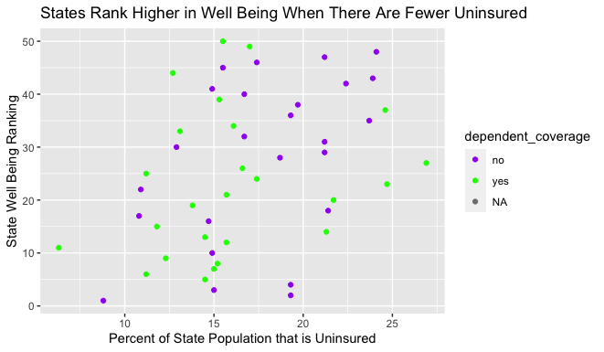
Manually Select Color Scale
ggplot(data=cspp_data,
aes(x=percentuninsured, y=wellbeing))+
geom_point(aes( color=dependent_coverage)) +
labs(title = 'States Rank Higher in Well Being When There Are Fewer Uninsured',
x = 'Percent of State Population that is Uninsured',
y = 'State Well Being Ranking' ) +
scale_color_manual(values= c("purple", "green"))
Now the legend shows the levels of the dependent_coverage factor variable
It assigns a color to each level

Slide 43
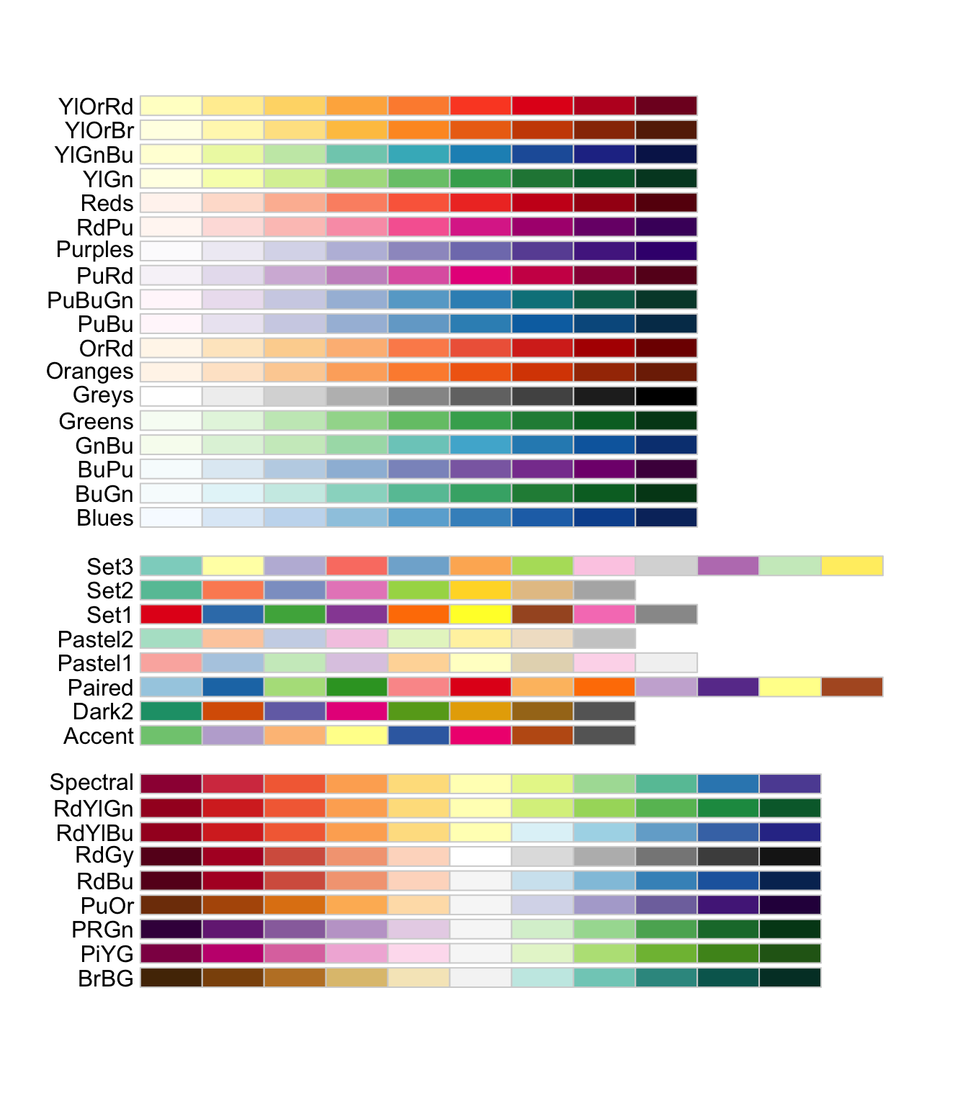
ColorBrewer Sequential Color Scales
ColorBrewer provides sets of colors (palettes)
Sequential palettes are good for ordinal categorical variables
Educational levels:
high school
college
graduate school

Slide 44
ColorBrewer Diverging Color Scales
Diverging palettes are good for ordinal categorical variables
Use this when your values are ordered in two directions relative to a center.
political affiliation:
liberal
centrist
conservative

Slide 45
ColorBrewer Qualitative Color Scales
Qualitative (nominal) palettes are good for categorical Variables whose values have no ordering.
Major:
Economics
Business
Statistics
https://pollev.com/vsovero

Slide 46
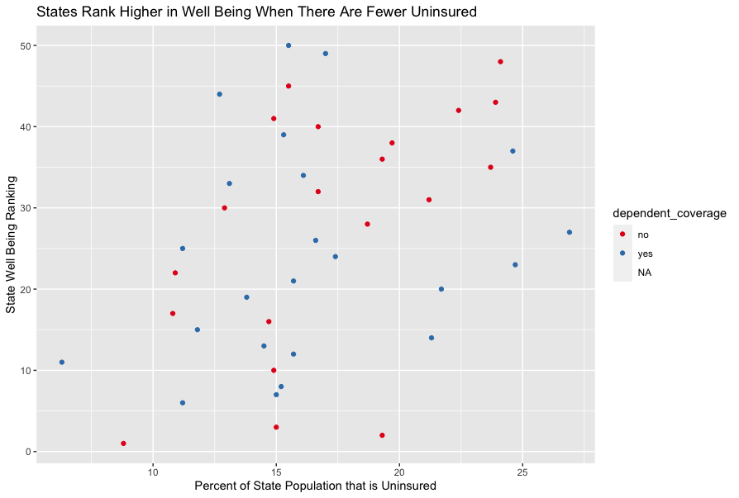
Palette Example
ggplot(data=cspp_data,
aes(x=percentuninsured, y=wellbeing))+
geom_point(aes( color=dependent_coverage)) +
labs(title = 'States Rank Higher in Well Being When There Are Fewer Uninsured',
x = 'Percent of State Population that is Uninsured',
y = 'State Well Being Ranking' ) +
scale_color_brewer(palette= "Set1")
When we select a palette, ggplot will take colors in the order in which they are listed on the palette
first color in Set1 is red, the second color is blue

Slide 47
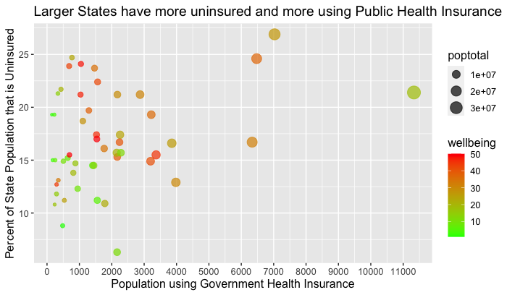
Use Themes
Themes control the non-data settings of the plot
theme() allows you to make adjustments to:
font size
legend position
Notes:
First, let’s apply the premade black and white theme. If you want to see what other themes are available, see ?theme_bw.
Demo 11:
· Copy paste the time series graph code
· Add theme_bw()
· ?theme_bw

Slide 48
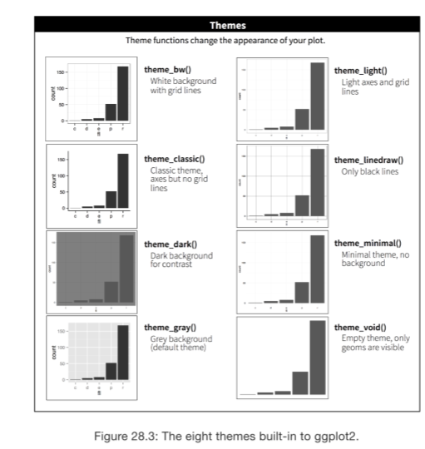
Use Themes
You can also use themes to change the grid settings:
Ex: theme_bw()
Apply theme using + operator
https://ggplot2.tidyverse.org/reference/ggtheme.html
Notes:
First, let’s apply the premade black and white theme. If you want to see what other themes are available, see ?theme_bw.
Demo 11:
· Copy paste the time series graph code
· Add theme_bw()
· ?theme_bw

Slide 49
Use Themes
ggplot(data=cspp_data,
aes(x=popgovhealthins, y=percentuninsured))+
geom_point(aes( color=wellbeing, size=poptotal), alpha=.7) +
labs(title = 'Larger States have more uninsured and more using Public Health Insurance',
x = 'Population using Government Health Insurance',
y = Percent of State Population that is Uninsured' ) +
scale_color_gradient(low= "green", high= "red", )+
theme(text=element_text(size=12, family="Arial")) + theme_bw()
Notes:
First, let’s apply the premade black and white theme. If you want to see what other themes are available, see ?theme_bw.
Demo 11:
· Copy paste the time series graph code
· Add theme_bw()
· ?theme_bw

